Slide 1
What is an Operating System?

Slide 2
introduction
Operating system is software, which makes a computer to actually work.
It is a software that runs on a computer.
It controls the computer’s memories and processes and more.
OS acts as an interface between the application programs and the machine hardware.

Slide 3
Operating system’s job
Process management:-
This module takes care of creation and deletion of processes and providing mechanisms for synchronization and communication among processes.
Memory Management:-
This module take care of allocation and de-allocation of memory space to programs in need of this resources.
File Management:-
It takes care of file-related activities such as organization storage, retrieval, naming, sharing, and protection of files.

Slide 4
Operating system’s job
Security:-
This module protects the resources and information of a computer system against destruction and unauthorised access.
Command Interpretation:-
This module takes care of Interpreting user commands and directing system resources to process the commands.

Slide 5
Some popular Operating System
Single User Systems:-
They are popularly associated with desk top operating system which run on standalone systems where no user accounts are required.
Example : DOS
Multi User Systems :-
Provides regulated access for a number of users by maintaining a database of known users. Refers to computer systems that support two or more simultaneous users.
Example: Unix, Microsoft Windows .

Slide 6
Types of PC based Operating Systems
Microsoft’s windows
Apple’s Mac OS
Linux
Unix
And more

Slide 7
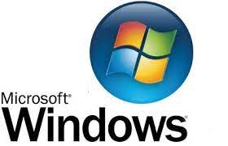
Microsoft’s windows
History – Created in mid-1980s
Information – There has been different versions of the Windows over the years
Latest versions – Windows 11, windows 10,windows 8 etc.

Slide 8
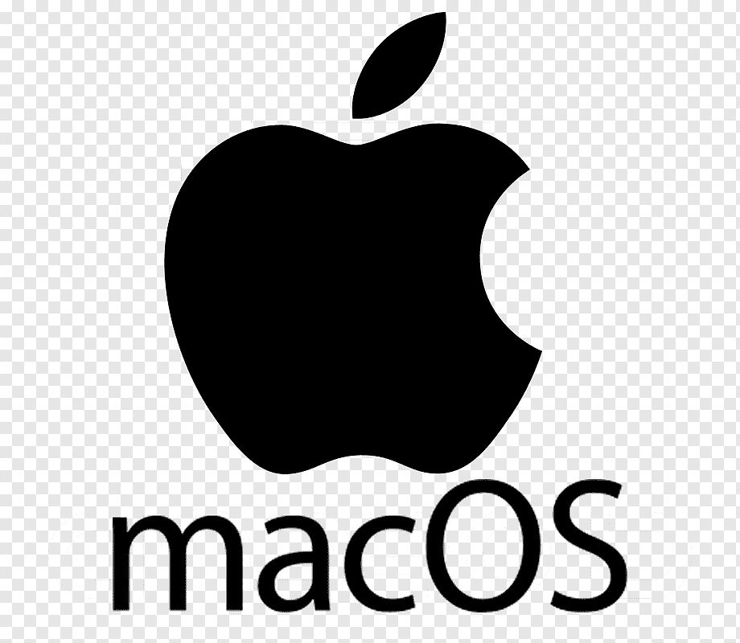
Apple’s Mac OS
History – it was introduced in 1984
Information – comes preloaded on all new macintosh computers or Macs
Latest versions – OS X, El Captain(2015),Yosemite(2014), etc.

Slide 9

Linux
History – created in 1991
Information – it is a family of open-source systems.
Latest version – Debain 9.3,Bodhi linux 4.4.0, peppermint 8 respin.

Slide 10
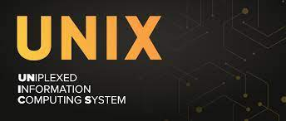
Unix
History – in 1969 the work on this operatinf]g system began.
Information – A multiuser operating system.
Latest version – UNIX 03,Solaris 9.0, Linux 2.6

Slide 11
Operating Systems for Mobile Devices
History – The first operating system was first used for texting.
Information- They run operating system that are specifically for mobile devices.
Latest version – Apple IOS and Google Android.

Slide 12
THANK YOU

